Slide 1
Graphics
Computer Vision
James Connan

Slide 2
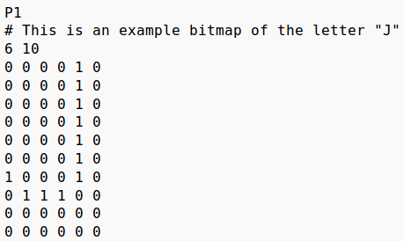

Image files – PBM
Bitmap

Slide 3
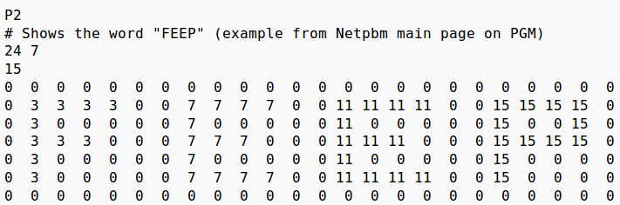

Image files – PGM
Grayscale

Slide 4
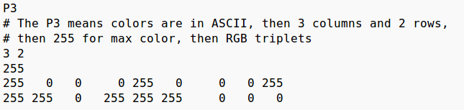

Image files – PPM
Colour (RGB) image

Slide 5
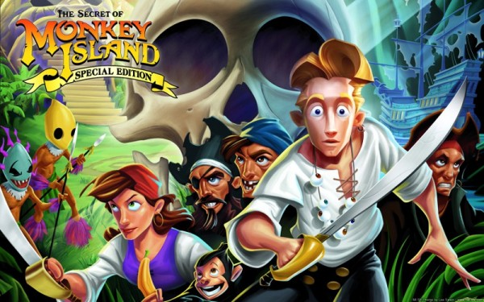
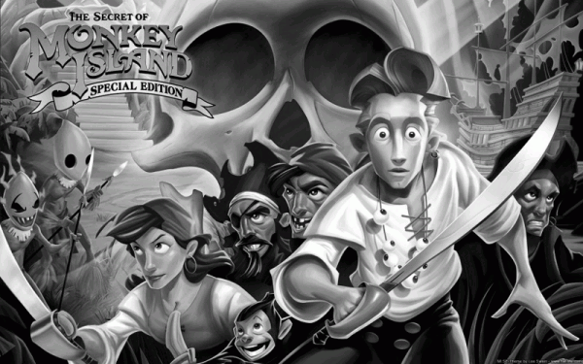
Grayscale (Basic)
Gray = (Red + Green + Blue) / 3

Slide 6
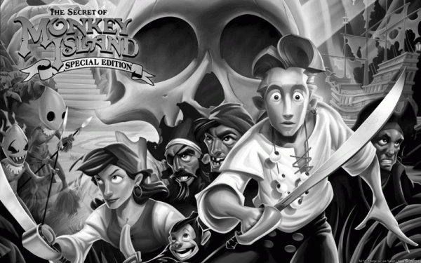
Grayscale (Correct)
Gray = (Red * 0.3 + Green * 0.59 + Blue * 0.11)

Slide 7

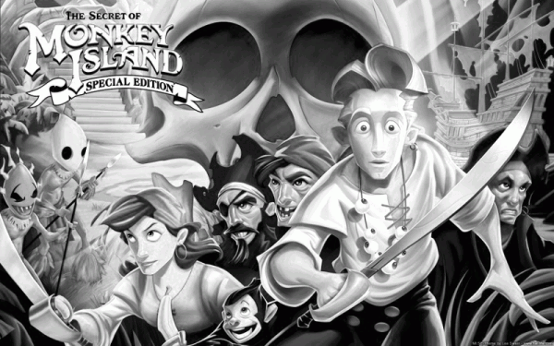
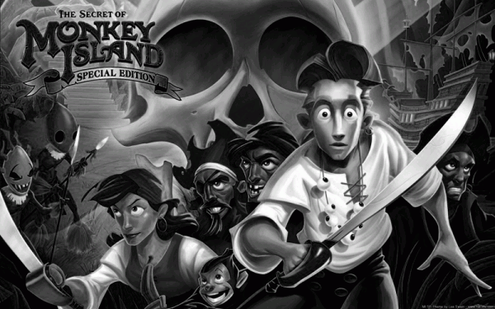
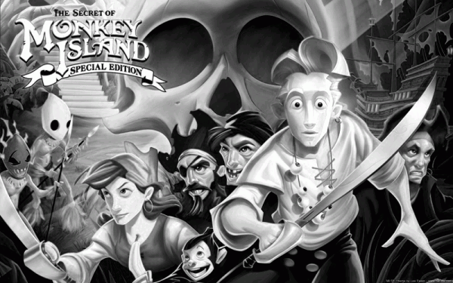
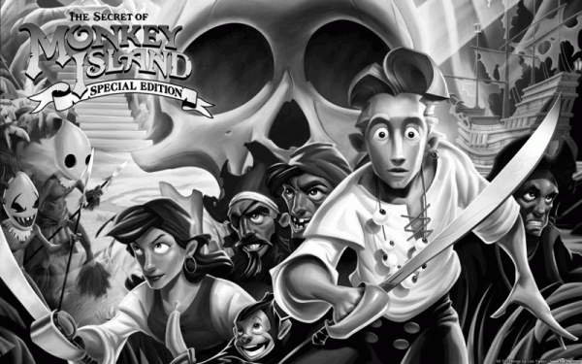
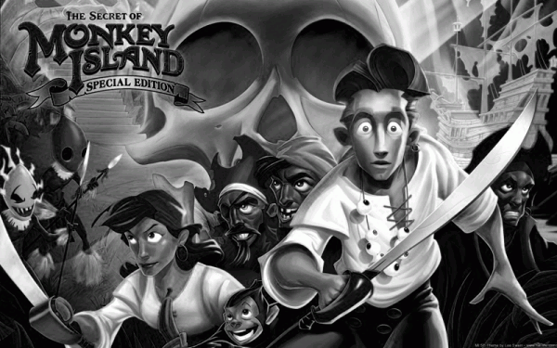
Crayscale (Comparison)
1/3
weight
desaturation
max
min
r
g
b

Slide 8
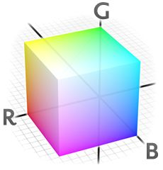
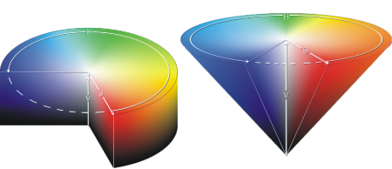




Colour Spaces
HSV/HSI

Slide 9





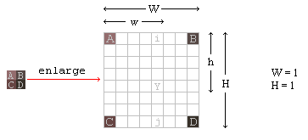


Image Scaling (Bilinear)
Scale
No Interpolation
Interpolation

Slide 10
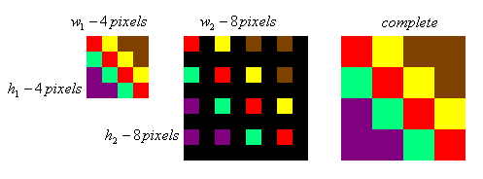
Image Scaling (NN)

Slide 11
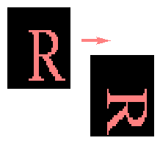

Image Rotation

Slide 12
Background Subtraction (Basic)
Background subtraction
  | framei – backgroundi | > Th
Frame differencing
  | framei – framei-1 | > Th
Running average
  B_{i + 1} = α * Fi + (1 - α) * Bi

Slide 13
Background Subtraction
Running average with selection
  Bi +1(x, y) = αFt(x, y) + (1−α )Bt(x, y) → if Ft(x, y) BG
  Bi +1(x, y) = Bt(x, y) → if Ft(x, y) FG
Running Gaussian average
Mixture of Gaussians
Kernel Density Estimators
Mean-shift based estimation
Combined estimation and propagation
Eigenbackgrounds

Slide 14
Tools
Ffmpeg
OpenCV
MEncoder

Slide 15
Task
Grayscale
  Single channel
  Average
  Correct
Scale
  Bigger and smaller
  NN and Interpolation
Rotate
Background subtraction
  Basic 3

